Slide 1
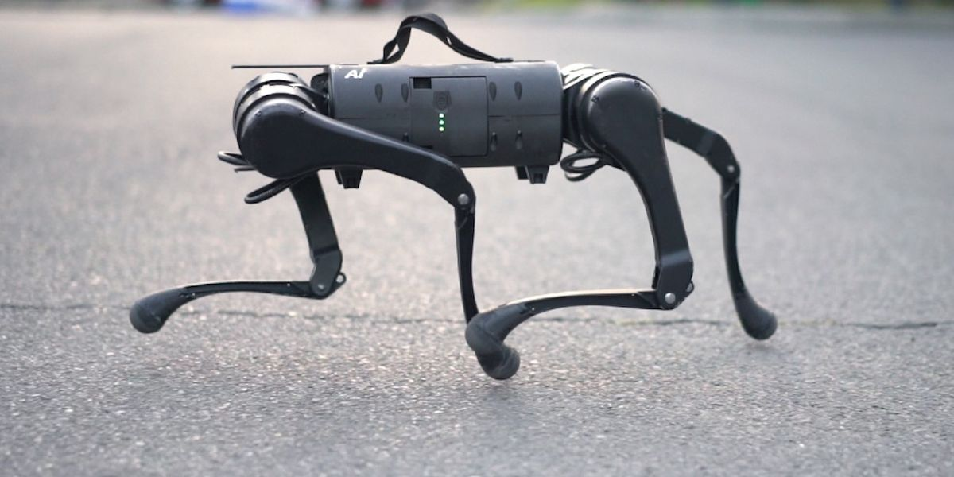
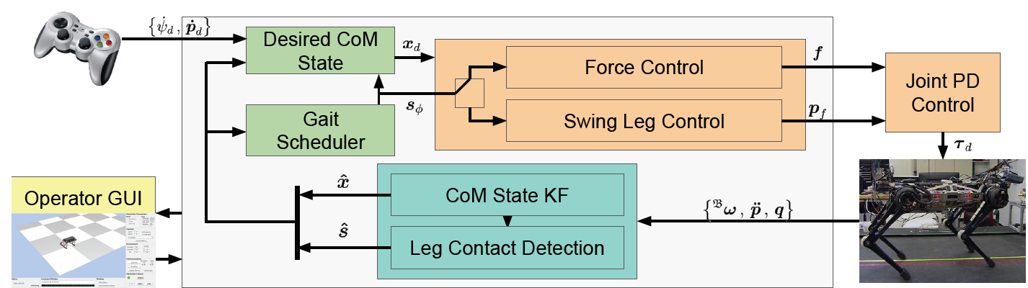
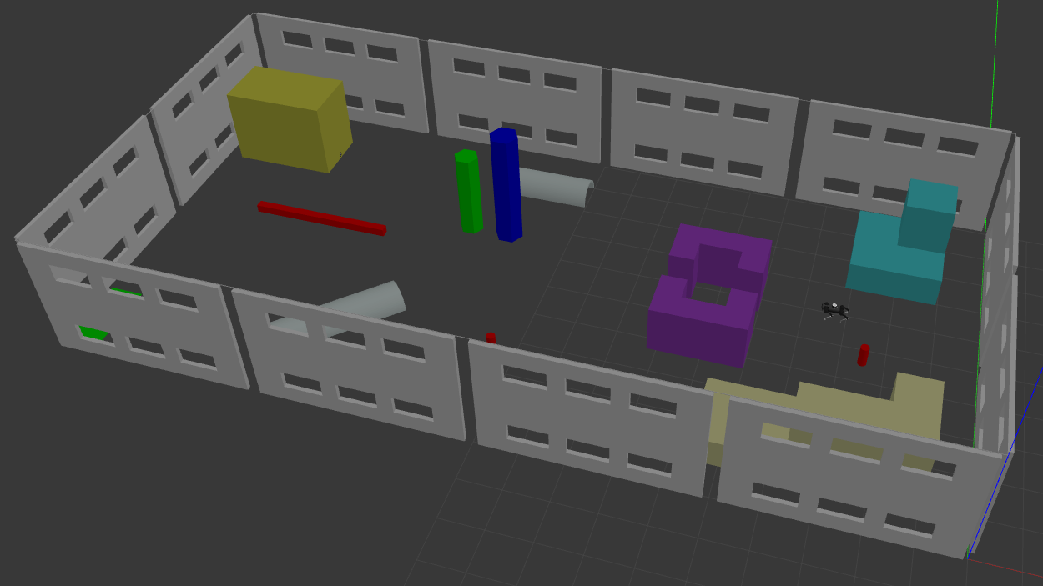
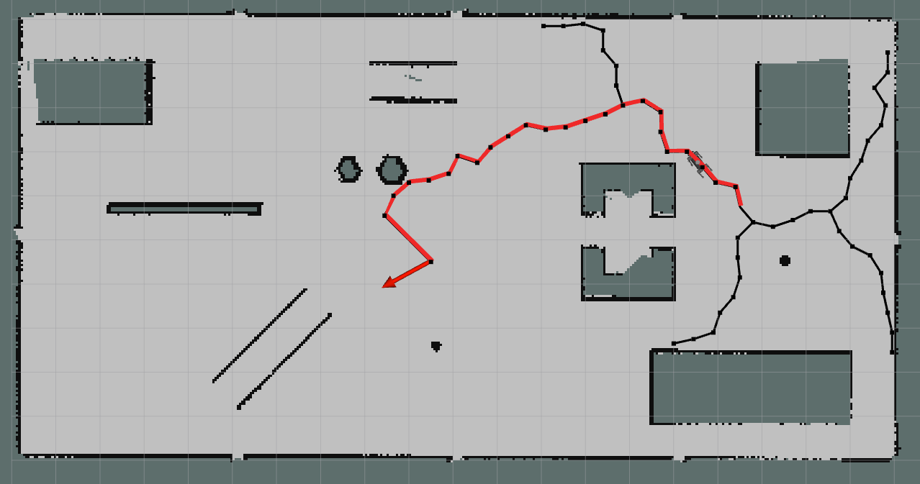
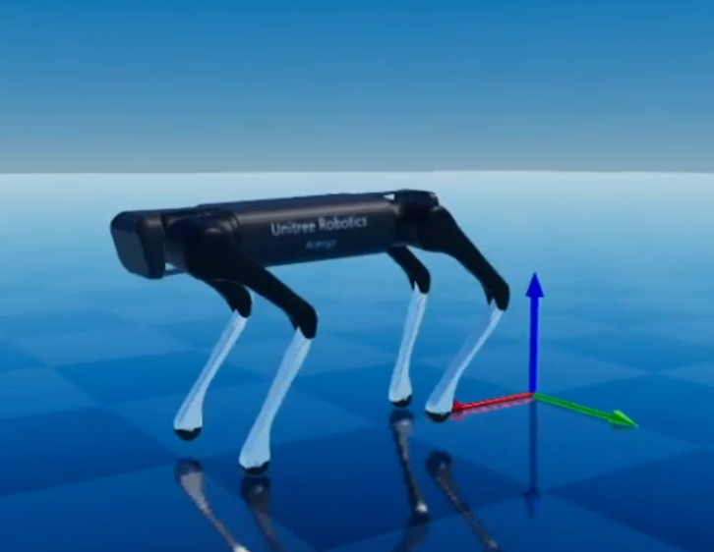
DIPARTIMENTO DI INGEGNERIA ELETTRICA E TECNOLOGIE DELL’INFORMAZIONE
SCUOLA POLITECNICA E DELLE SCIENZE DI BASE
FIELD AND SERVICE ROBOTICS – Technical Report
Model-Based and Data-Driven Control of a Quadruped Robot
Emanuele Cuzzocrea, Vito Daniele Perfetta
Prof. Fabio Ruggiero

Slide 2

INTRODUCTION
Quadruped Robots A1 and Aliengo
Model-based Control MPC and Gait Analysis
Path Planning Rapidly Exploring Random Tree (RRT)
Data-driven Control Reward Machines and Gait Analysis
Conclusions
MODEL-BASED AND DATA-DRIVEN CONTROL OF A QUADRUPED ROBOT 2 / 34

Slide 3
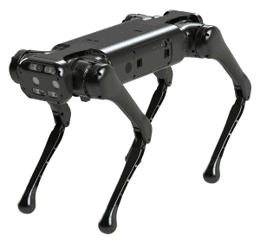
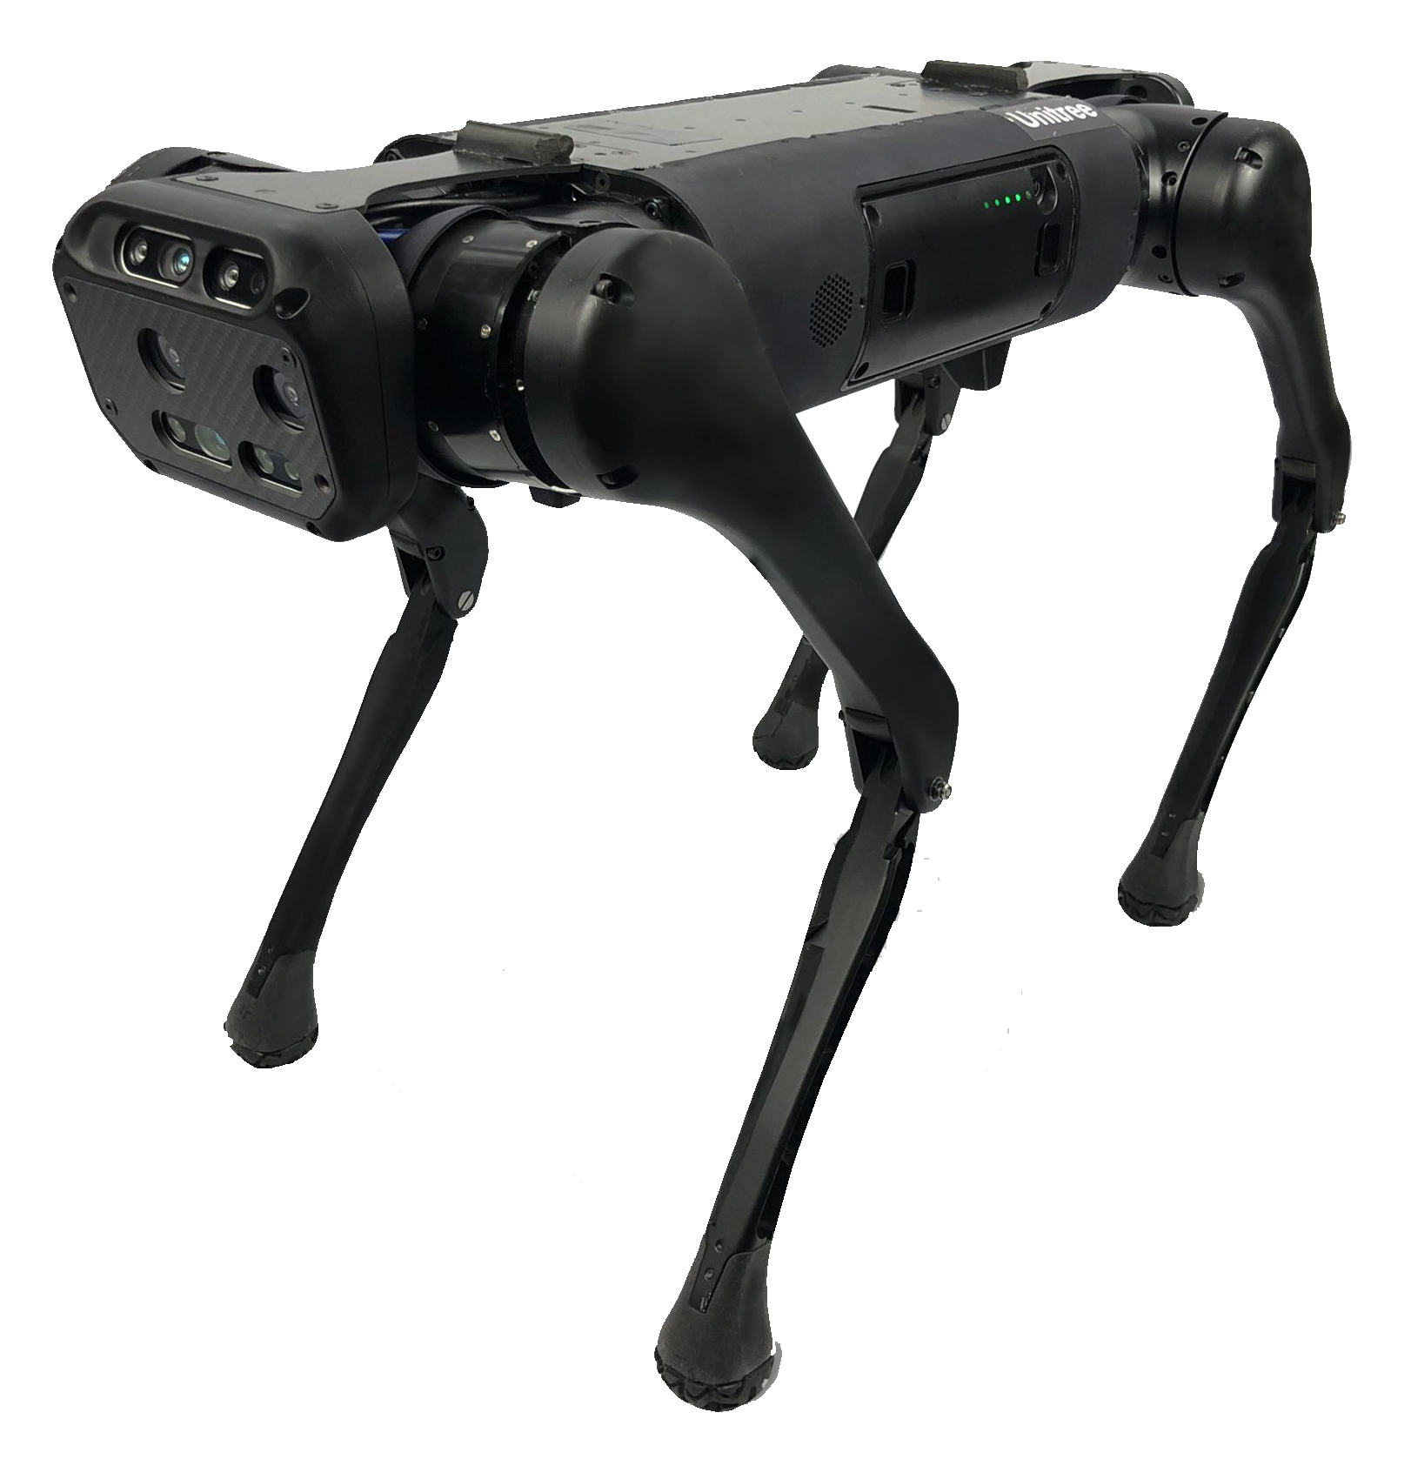
QUADRUPED ROBOTS
Unitree A1 Dog Robot
Unitree Aliengo Dog Robot
Used for the Model-based control
Used for the Data-driven control
MODEL-BASED AND DATA-DRIVEN CONTROL OF A QUADRUPED ROBOT 3 / 34

Slide 4
MODEL-BASED CONTROL
The operator provides desired translational velocity and turning rate
These commands are used to plan the CoM reference trajectory
2 controllers: swing leg and stance leg control
MODEL-BASED AND DATA-DRIVEN CONTROL OF A QUADRUPED ROBOT 4 / 34

Slide 5
MODEL-BASED CONTROL
Swing Leg Control
$$τ_{i}=J_{i}^{T}\left[K_{p}(p_{i.ref}^{b} − p_{i}^{b}) +K_{d}(v_{i,ref}^{b}−v_{i}^{b})\right]+τ_{i,ff}$$
$$τ_{i,ff}=J_{i}^{T}Λ_{i}\left(a_{i,ref}^{b}−{\dot{J}}_{i}{\dot{q}}_{i}\right)+C_{i}{\dot{q}}_{i}+G_{i}$$
Stance Leg Control
$$τ_{i}=J_{i}^{T}R_{i}f_{i}$$
$$f_{i}=MPC\left(x\right)$$
MODEL-BASED AND DATA-DRIVEN CONTROL OF A QUADRUPED ROBOT 5 / 34

Slide 6
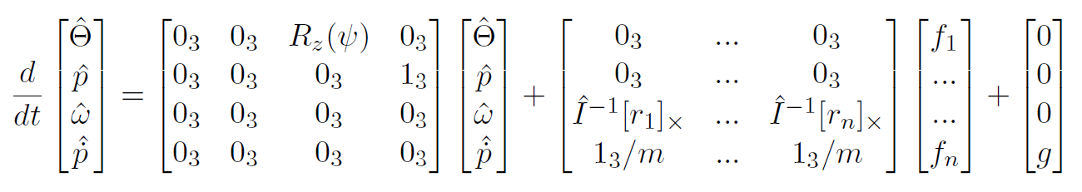
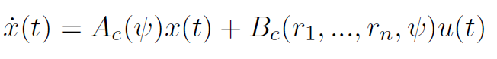
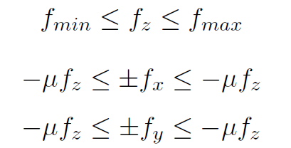
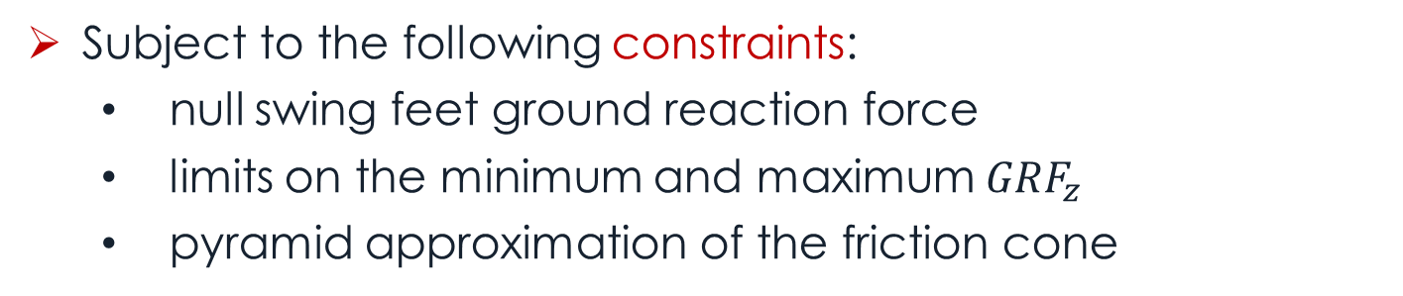
MODEL-BASED CONTROL
Neglecting the leg dynamics, the simplified robot dynamic model is
Adding the gravity term in the state vector, i.e. $x\left(t\right)={\left[\begin{matrix}\hat{Θ} & \hat{p} & \begin{matrix}\hat{ω} & \hat{\dot{p}} & g\end{matrix}\end{matrix}\right]}^{T} ,u_{i}\left(t\right)=f_{i}$
Subject to the following constraints:
null swing feet ground reaction force
limits on the minimum and maximum $GRF_{z}$
pyramid approximation of the friction cone
MODEL-BASED AND DATA-DRIVEN CONTROL OF A QUADRUPED ROBOT 6 / 34

Slide 7
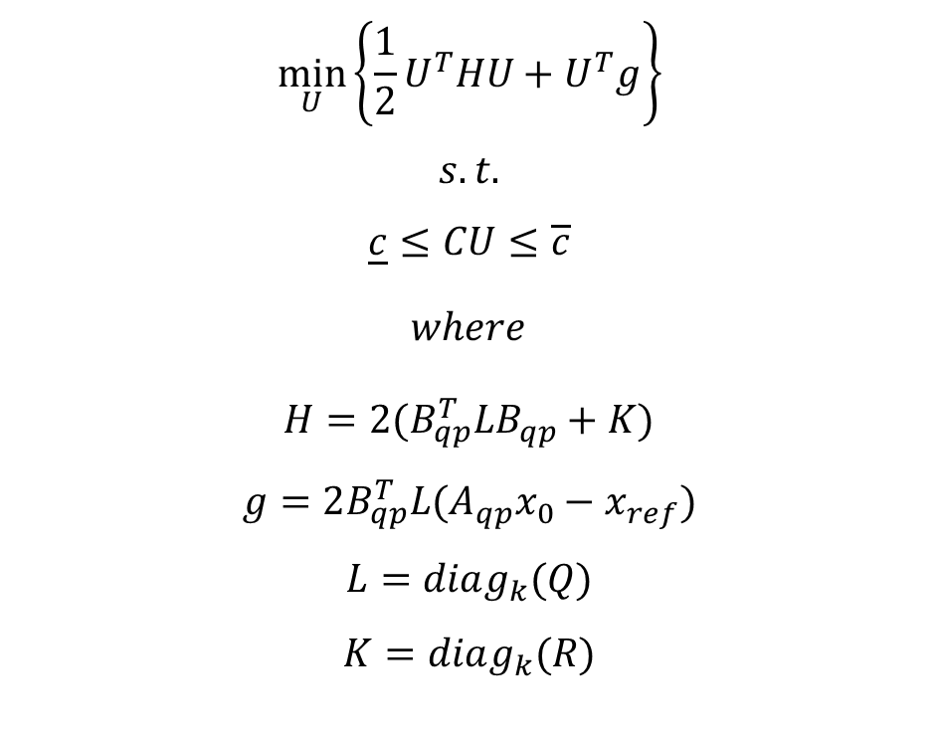
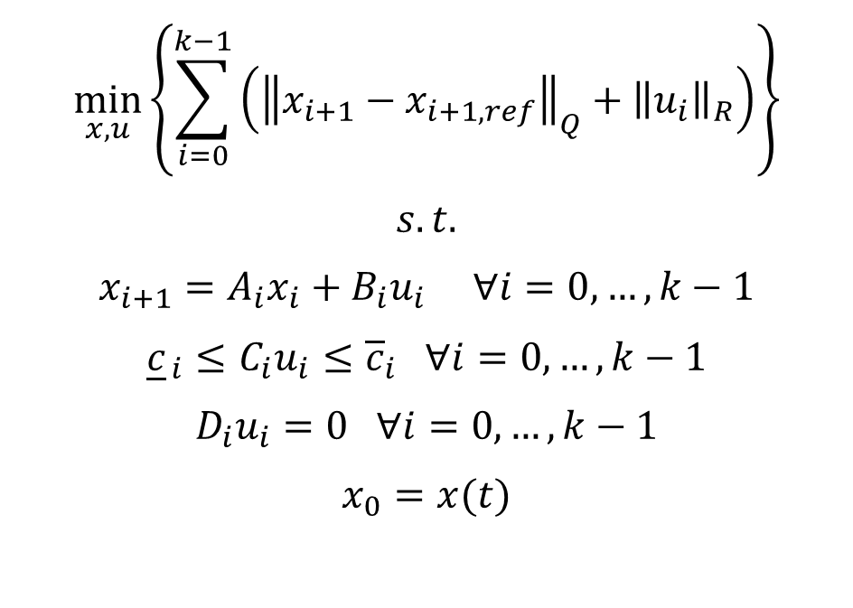
MODEL PREDICTIVE CONTROL
$$\min_{x,u}\left\{\sum_{i=0}^{k−1}{\left({\left\|x_{i+1}−x_{i+1,ref}\right\|}_{Q}+{\left\|u_{i}\right\|}_{R}\right)}\right\}$$
$$s.t.$$
$$x_{i+1}=A_{i}x_{i}+B_{i}u_{i} ∀i=0,…,k−1$$
$${\underline{c}}_{ i}≤C_{i}u_{i}≤{\overline{c}}_{i} ∀i=0,…,k−1$$
$$D_{i}u_{i}=0 ∀i=0,…,k−1$$
$$x_{0}=x(t)$$
$$\min_{U}\left\{\frac{1}{2}U^{T}HU+U^{T}g\right\}$$
$$s.t.$$
$$\underline{c}≤CU≤\overline{c}$$
$where$
$$H=2(B_{qp}^{T}LB_{qp}+K)$$
$$g=2B_{qp}^{T}L(A_{qp}x_{0}−x_{ref})$$
$$L=diag_{k}(Q)$$
$$K=diag_{k}(R)$$
MODEL-BASED AND DATA-DRIVEN CONTROL OF A QUADRUPED ROBOT 7 / 34

Slide 8
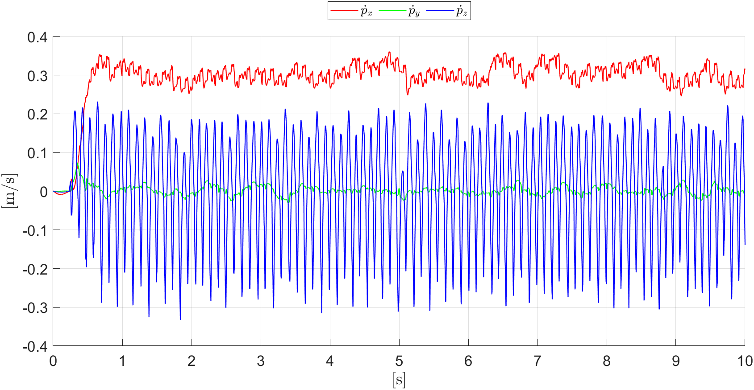
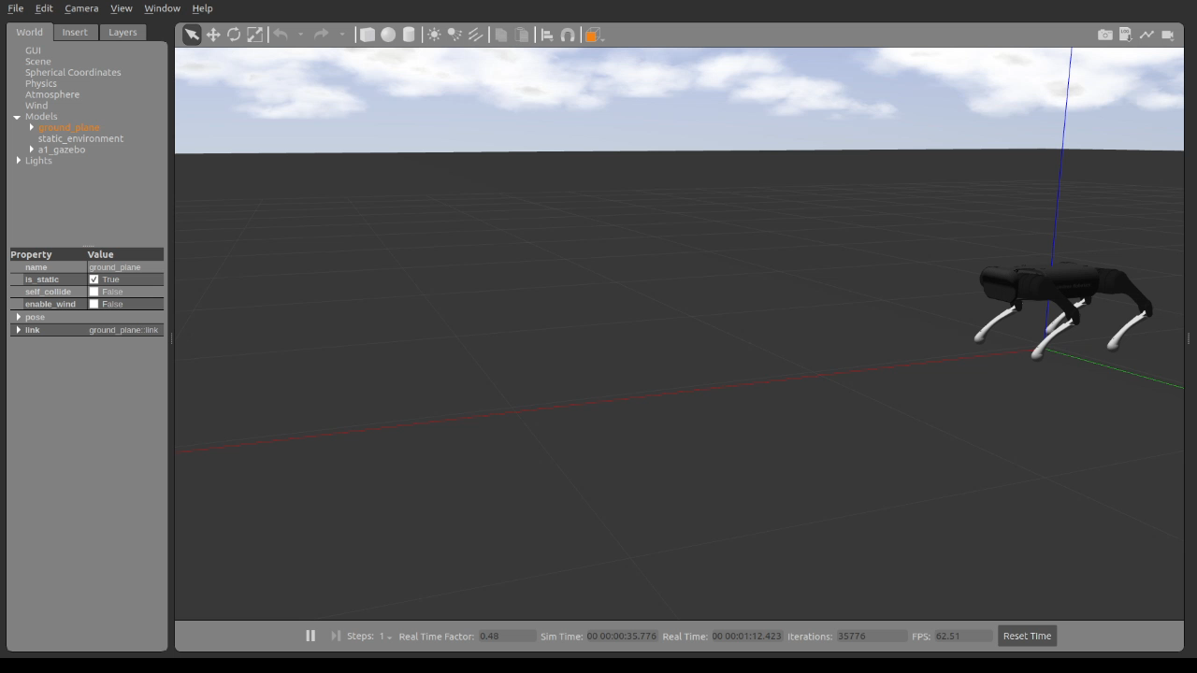
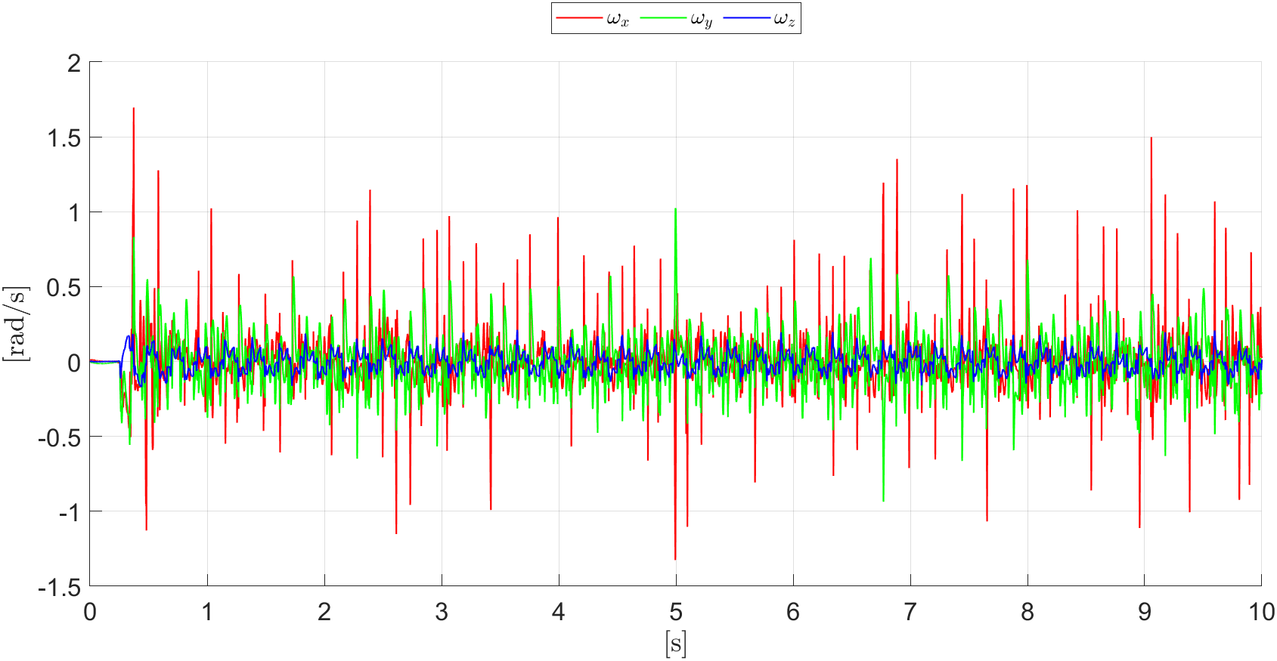
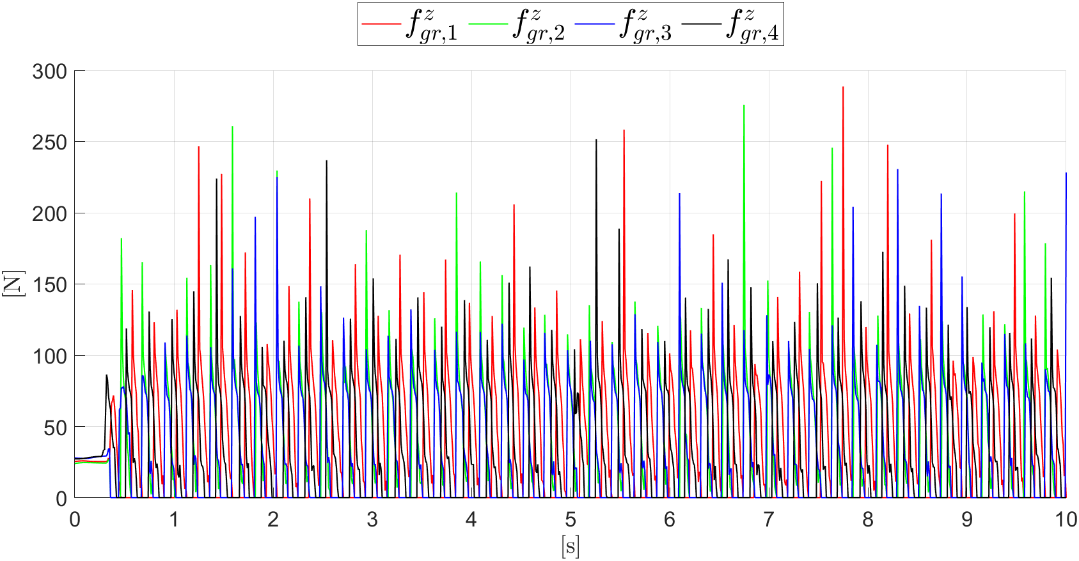
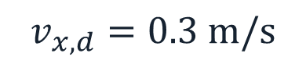
Linear Velocities
GAIT ANALYSIS – TROT
Angular Velocities
Ground Reaction Forces
$$v_{x,d}=0.3 \text{m}\text{/}\text{s}$$
MODEL-BASED AND DATA-DRIVEN CONTROL OF A QUADRUPED ROBOT 8 / 34

Slide 9
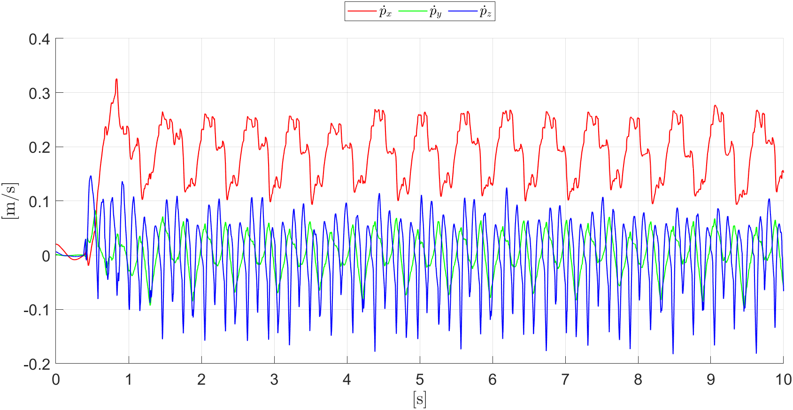
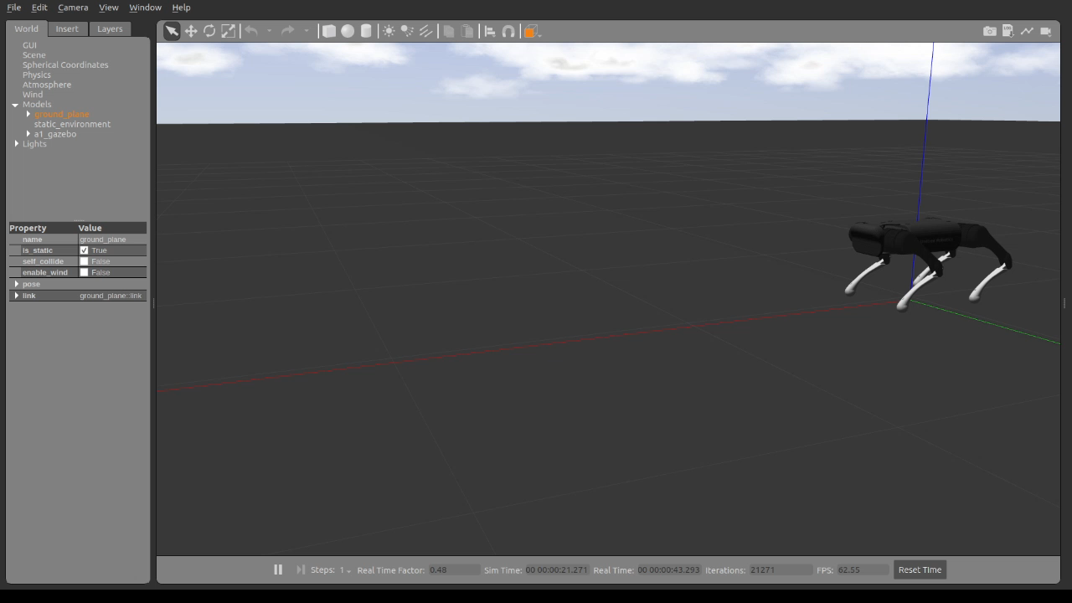
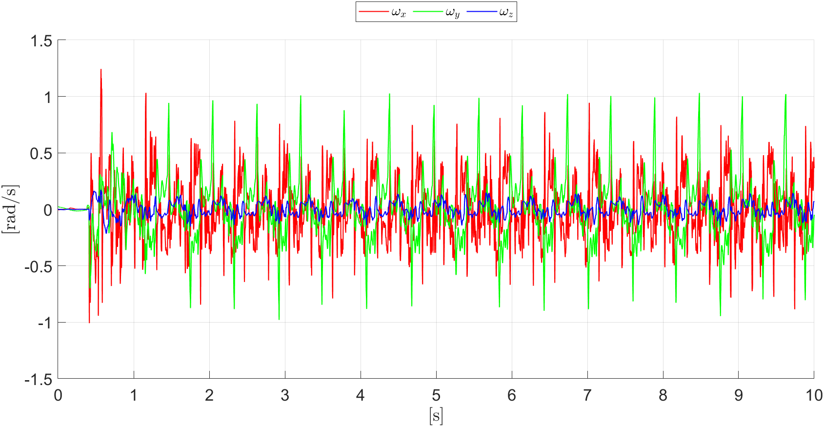
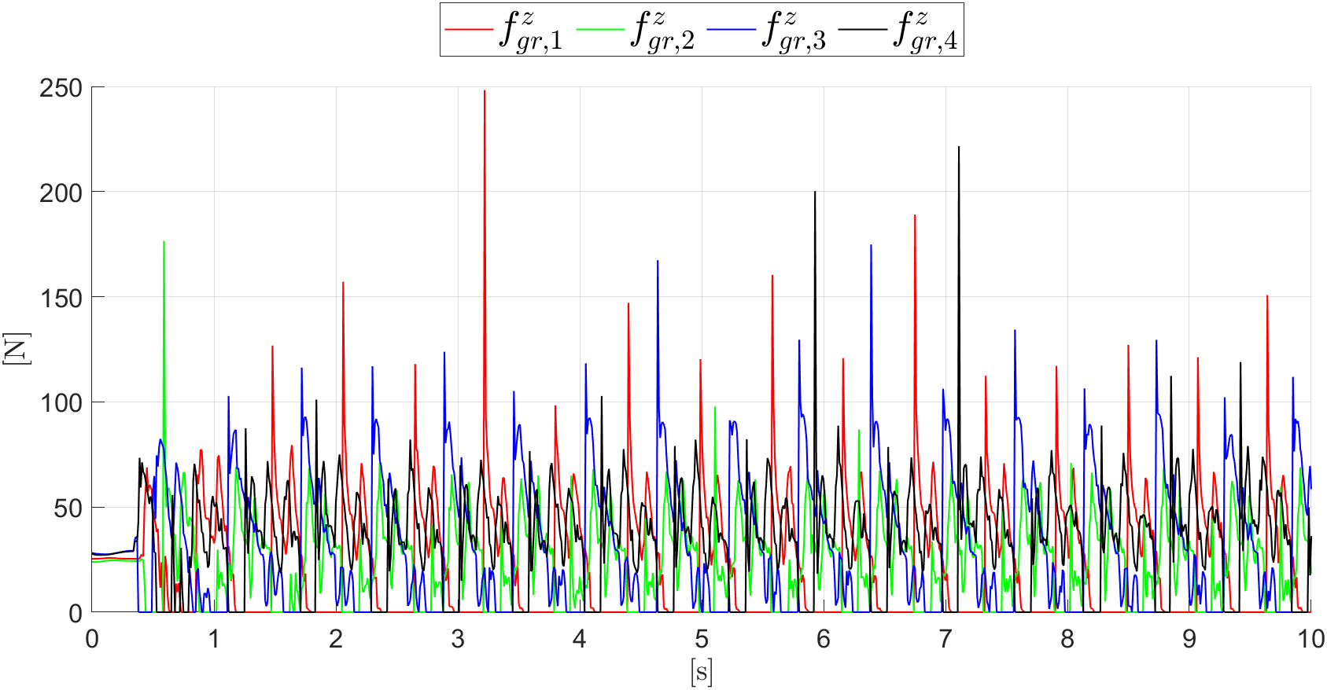
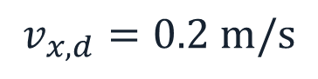
Linear Velocities
GAIT ANALYSIS – CRAWL
Angular Velocities
Ground Reaction Forces
$$v_{x,d}=0.2 \text{m}\text{/}\text{s}$$
MODEL-BASED AND DATA-DRIVEN CONTROL OF A QUADRUPED ROBOT 9 / 34

Slide 10
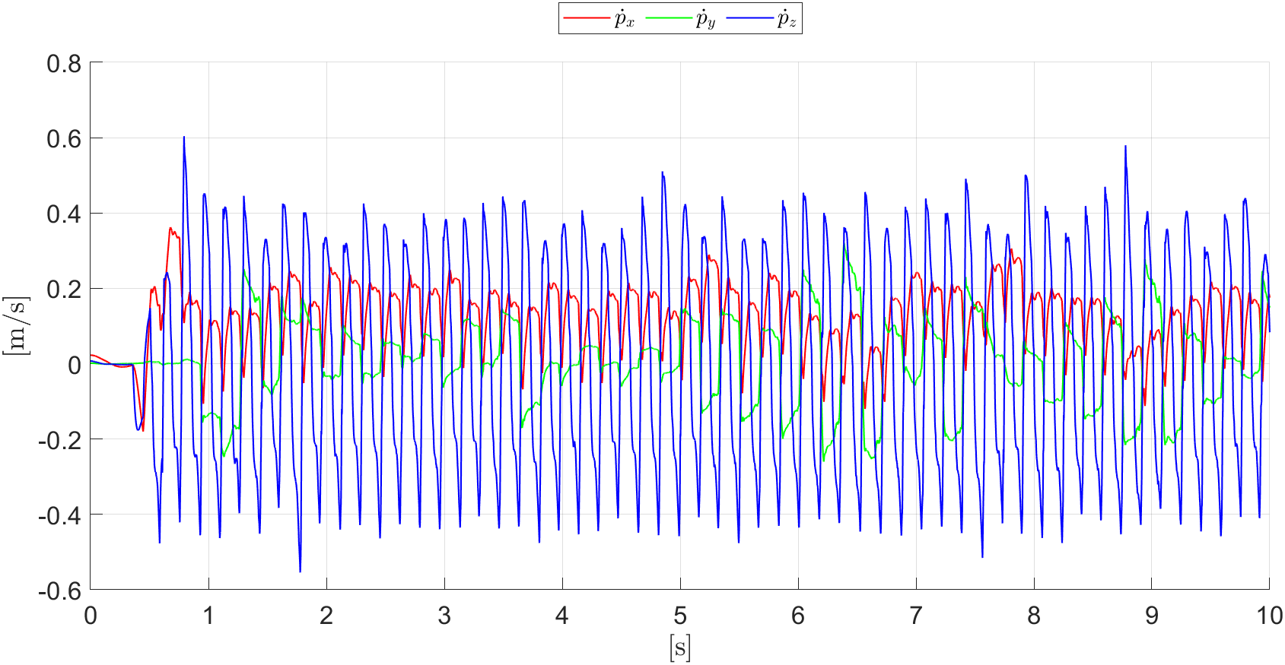
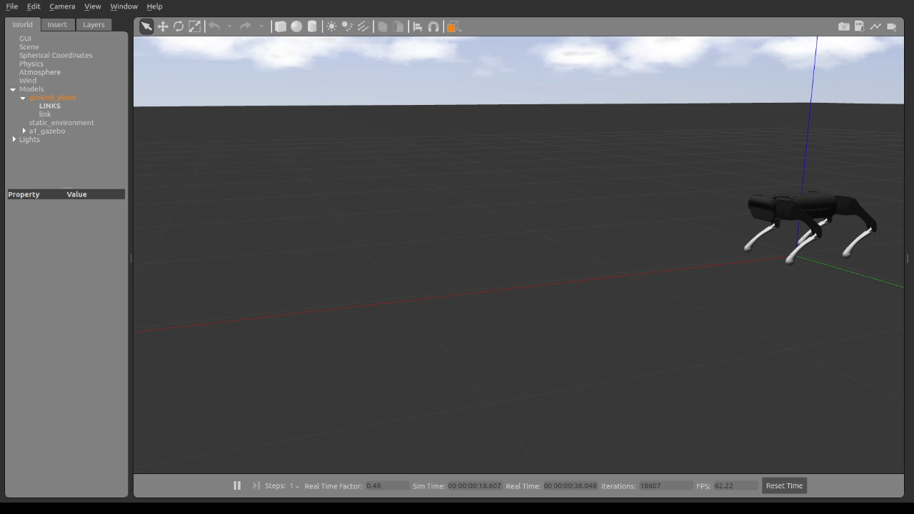
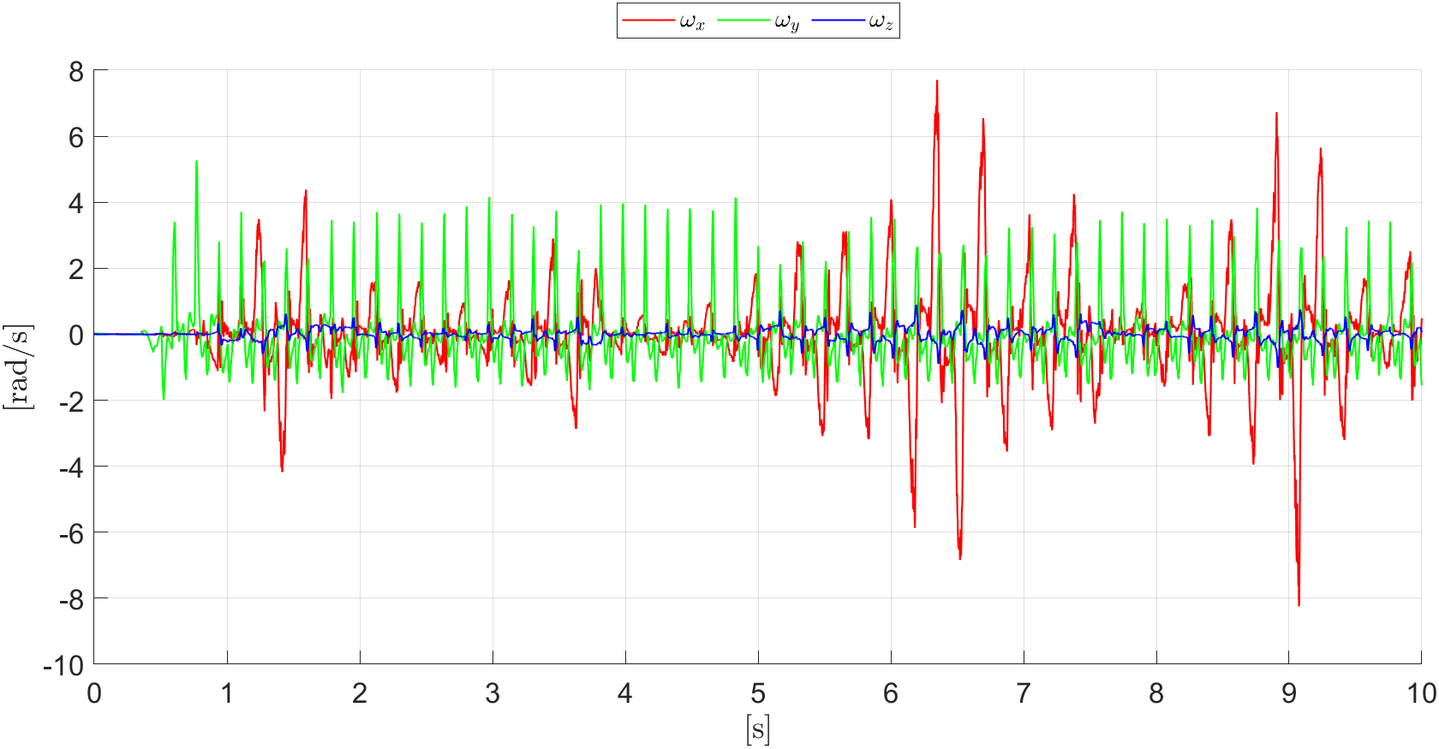
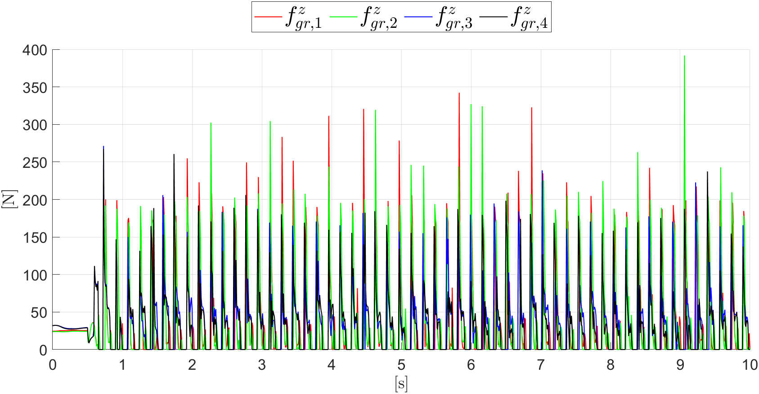
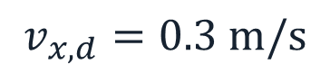
Linear Velocities
GAIT ANALYSIS – BOUND
Angular Velocities
Ground Reaction Forces
$$v_{x,d}=0.3 \text{m}\text{/}\text{s}$$
MODEL-BASED AND DATA-DRIVEN CONTROL OF A QUADRUPED ROBOT 10 / 34

Slide 11
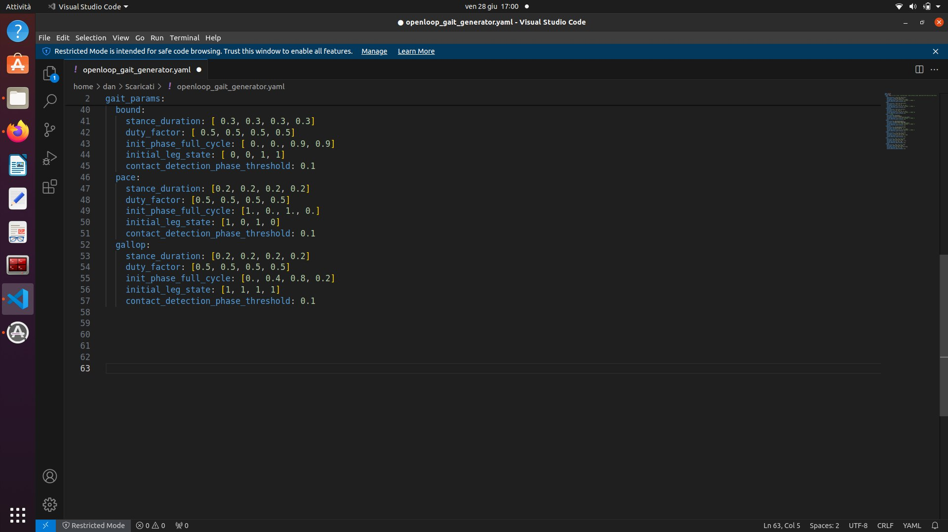

ADDING NEW GAITS
Gait implementation:
stance_duration: amount of stance time for each leg in a gait cycle.
duty_factor: fraction of stance phase in the gait cycle.
init_phase_full_cycle: initial phase of each leg at the beginning of the full cycle.
initial_leg_state: initial state of each leg, where 1 indicates "STANCE" and 0 indicates "SWING".
contact_detection_phase_threshold: contact threshold when the leg state switches from "SWING" to "STANCE".
Control tuning:
$$Q=[10, 10, 5, 60, 60, 100, 0., 0., 0.5, 50,100,1,0]$$
$$R=4⋅{10}^{−6} I_{12}$$
MODEL-BASED AND DATA-DRIVEN CONTROL OF A QUADRUPED ROBOT 11 / 34

Slide 12
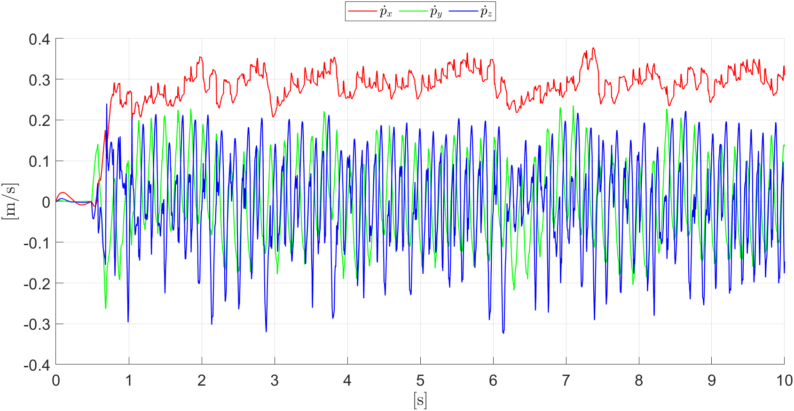
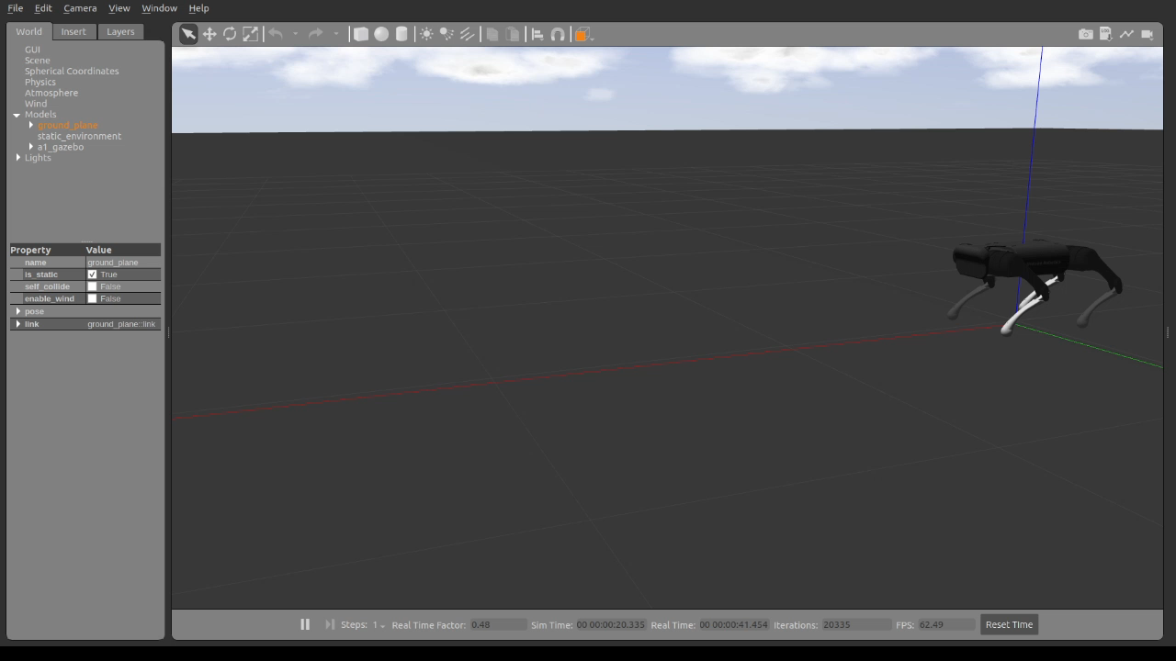
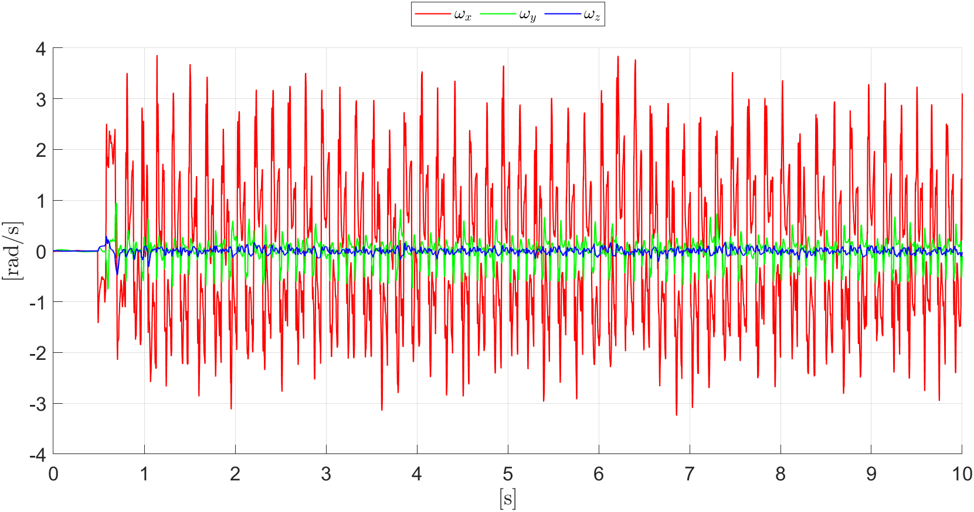
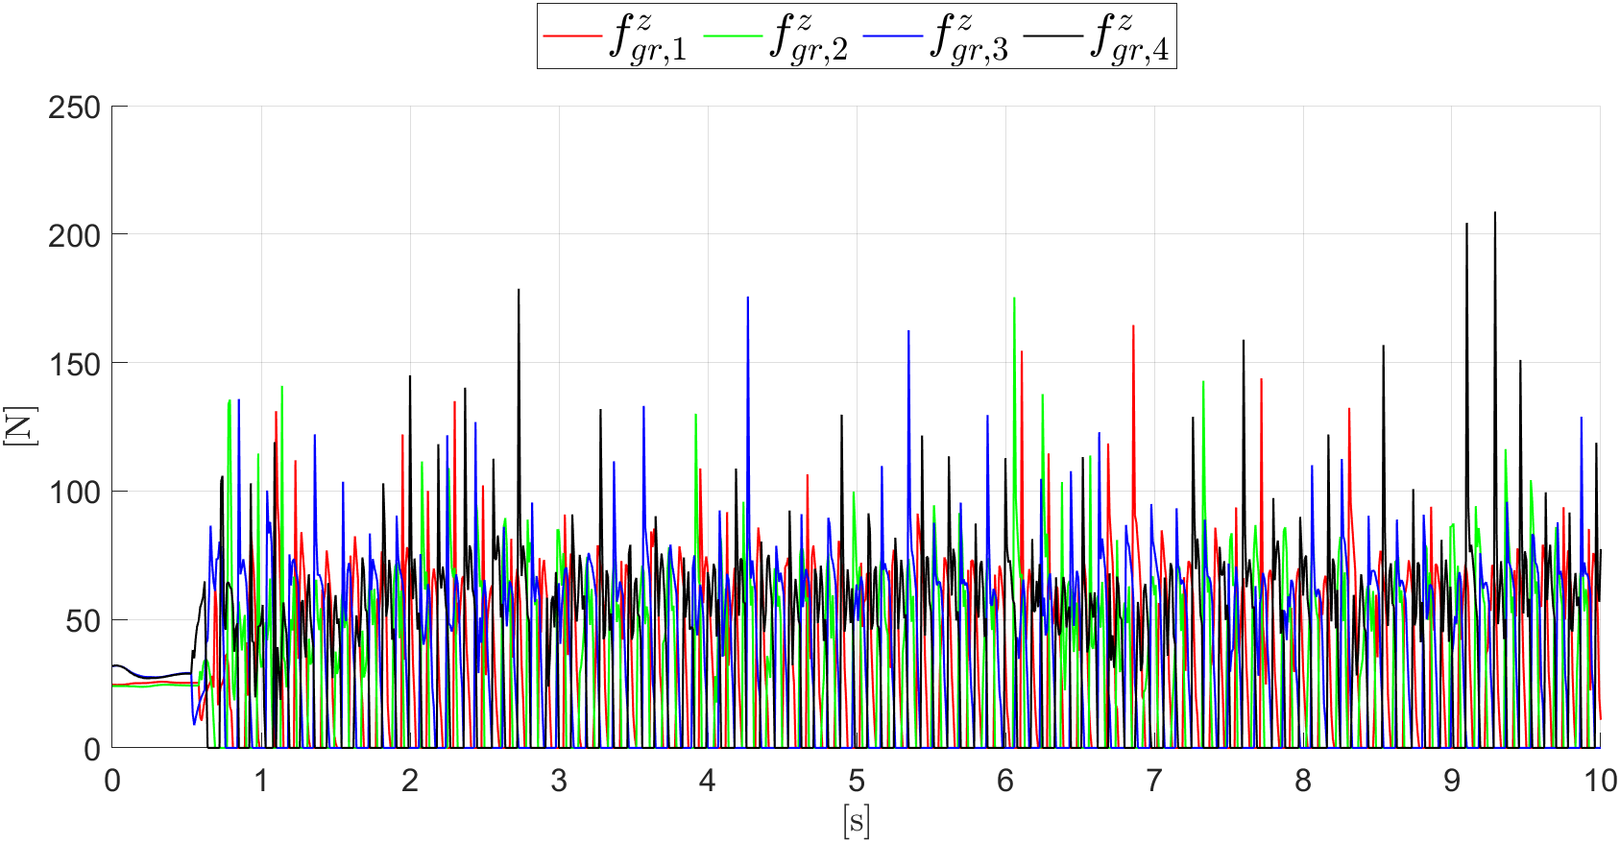

Linear Velocities
GAIT ANALYSIS – PACE
Angular Velocities
Ground Reaction Forces
$$v_{x,d}=0.3 \text{m}\text{/}\text{s}$$
MODEL-BASED AND DATA-DRIVEN CONTROL OF A QUADRUPED ROBOT 12 / 34

Slide 13
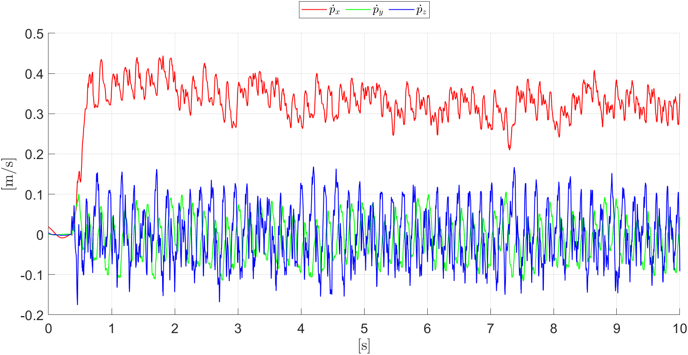
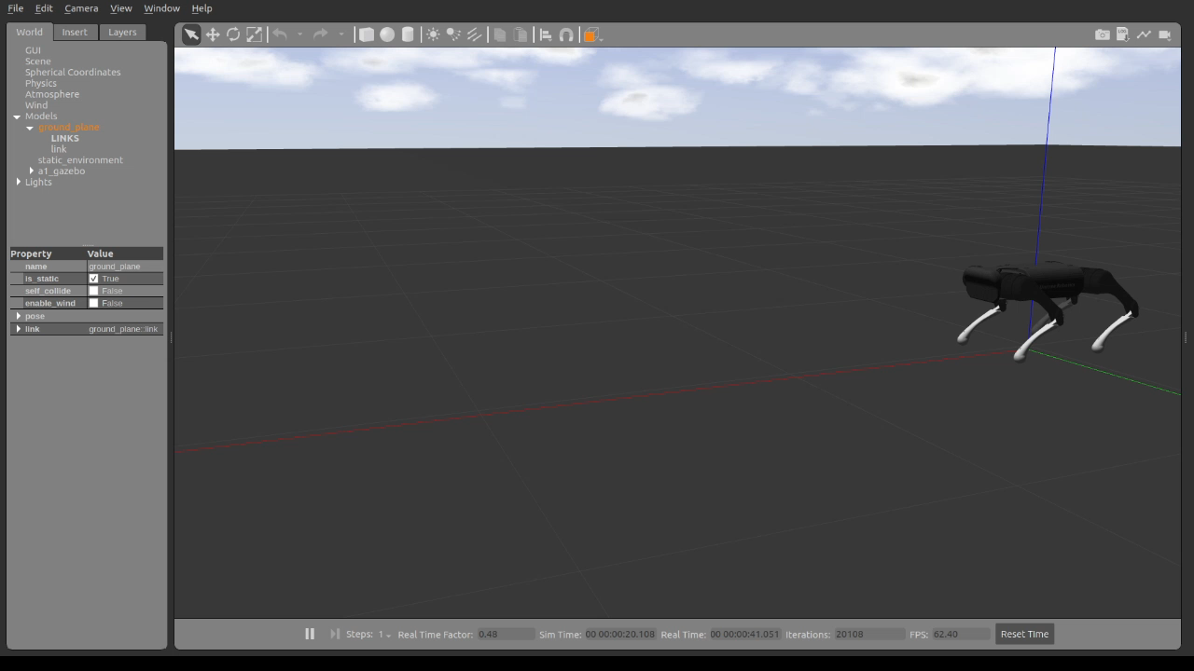
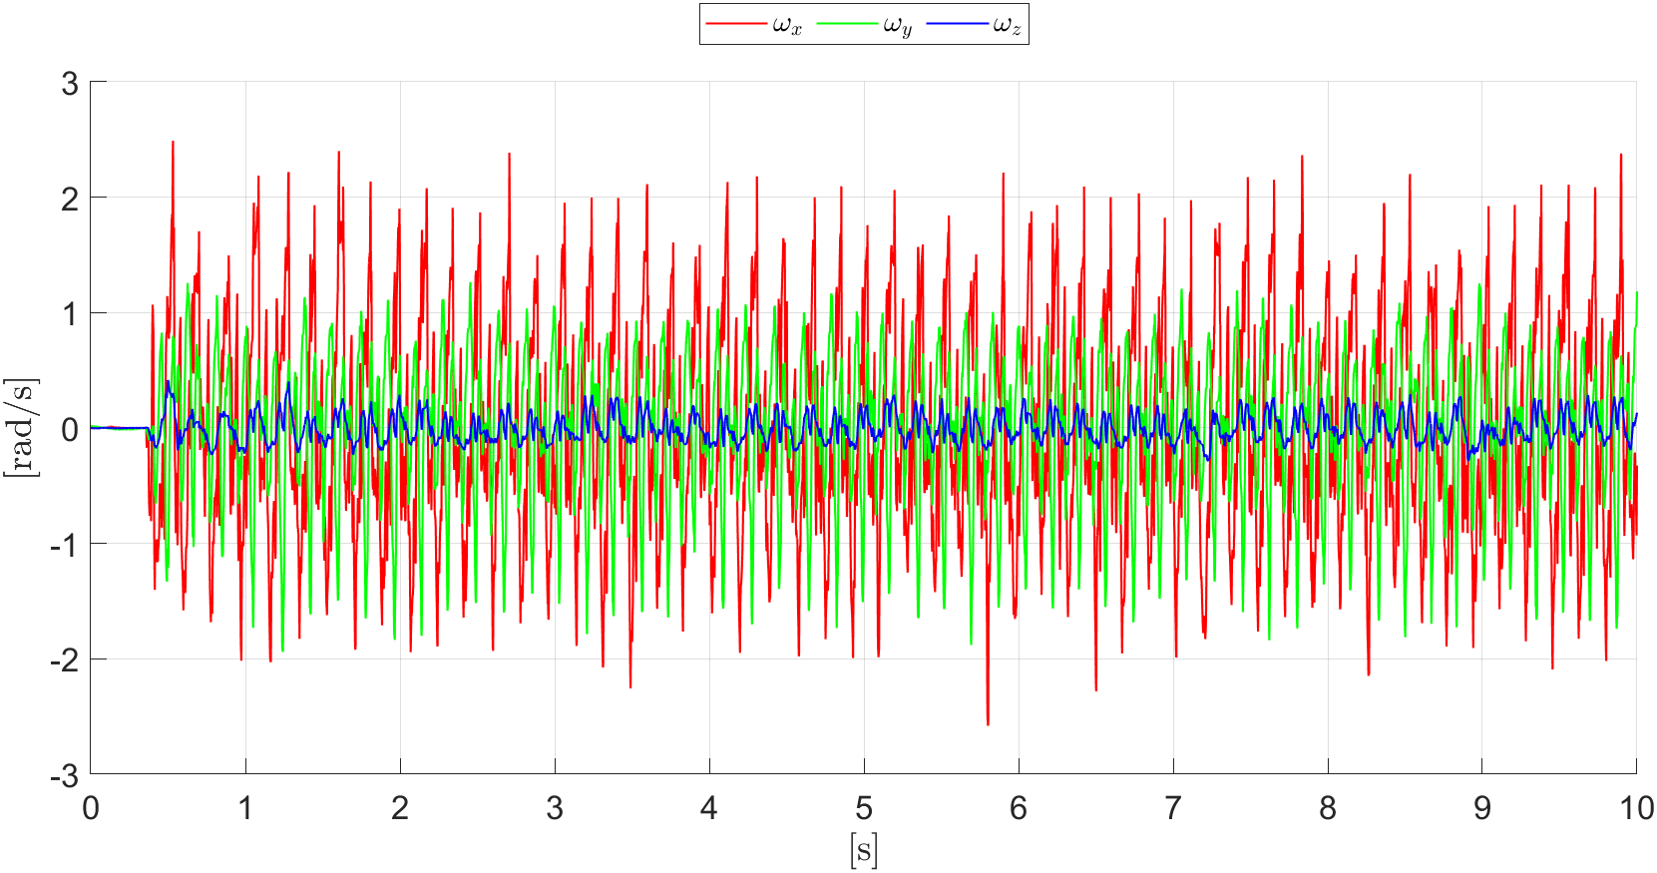
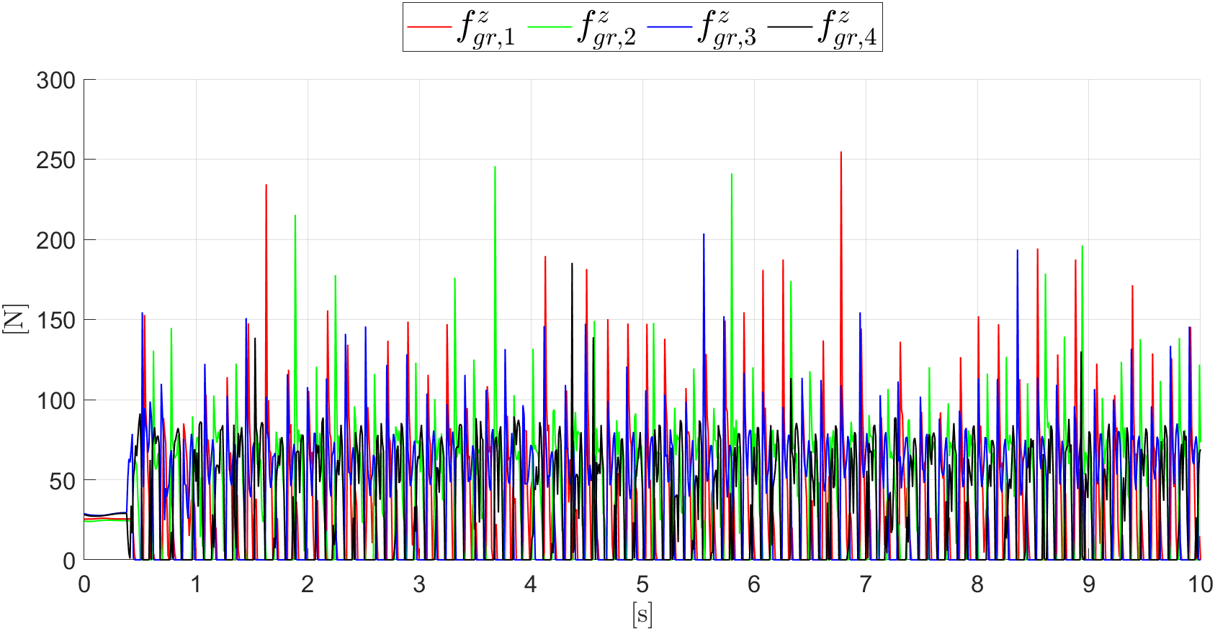

Linear Velocities
GAIT ANALYSIS – GALLOP
Angular Velocities
Ground Reaction Forces
$$v_{x,d}=0.3 \text{m}\text{/}\text{s}$$
MODEL-BASED AND DATA-DRIVEN CONTROL OF A QUADRUPED ROBOT 13 / 34

Slide 14
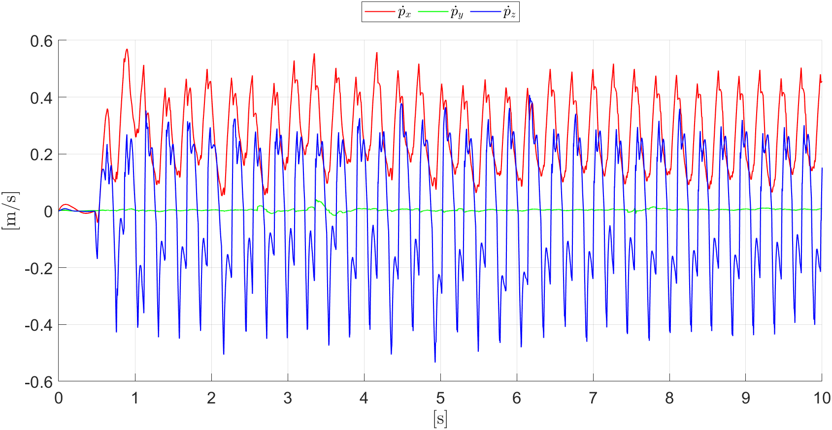
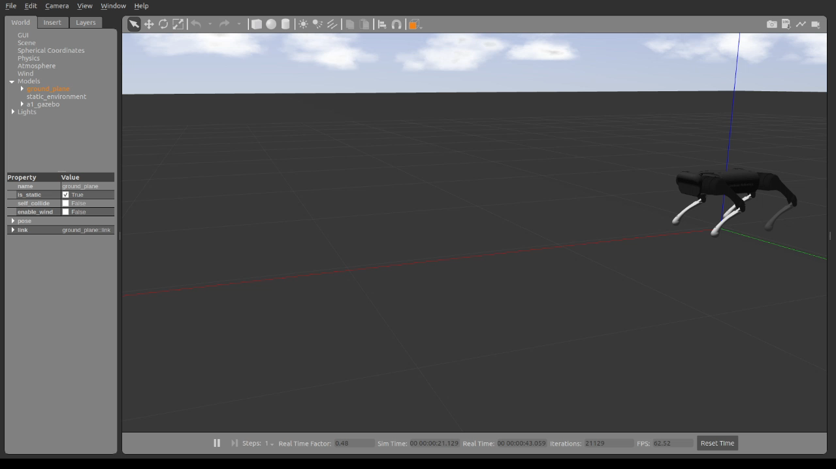
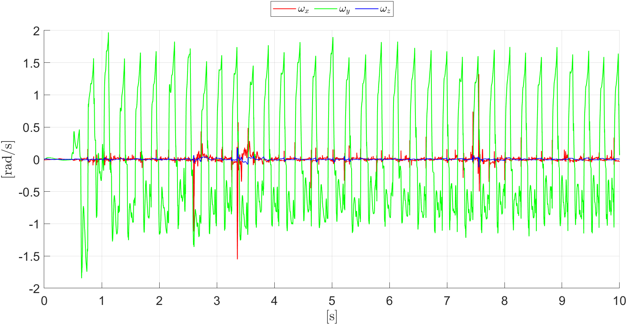
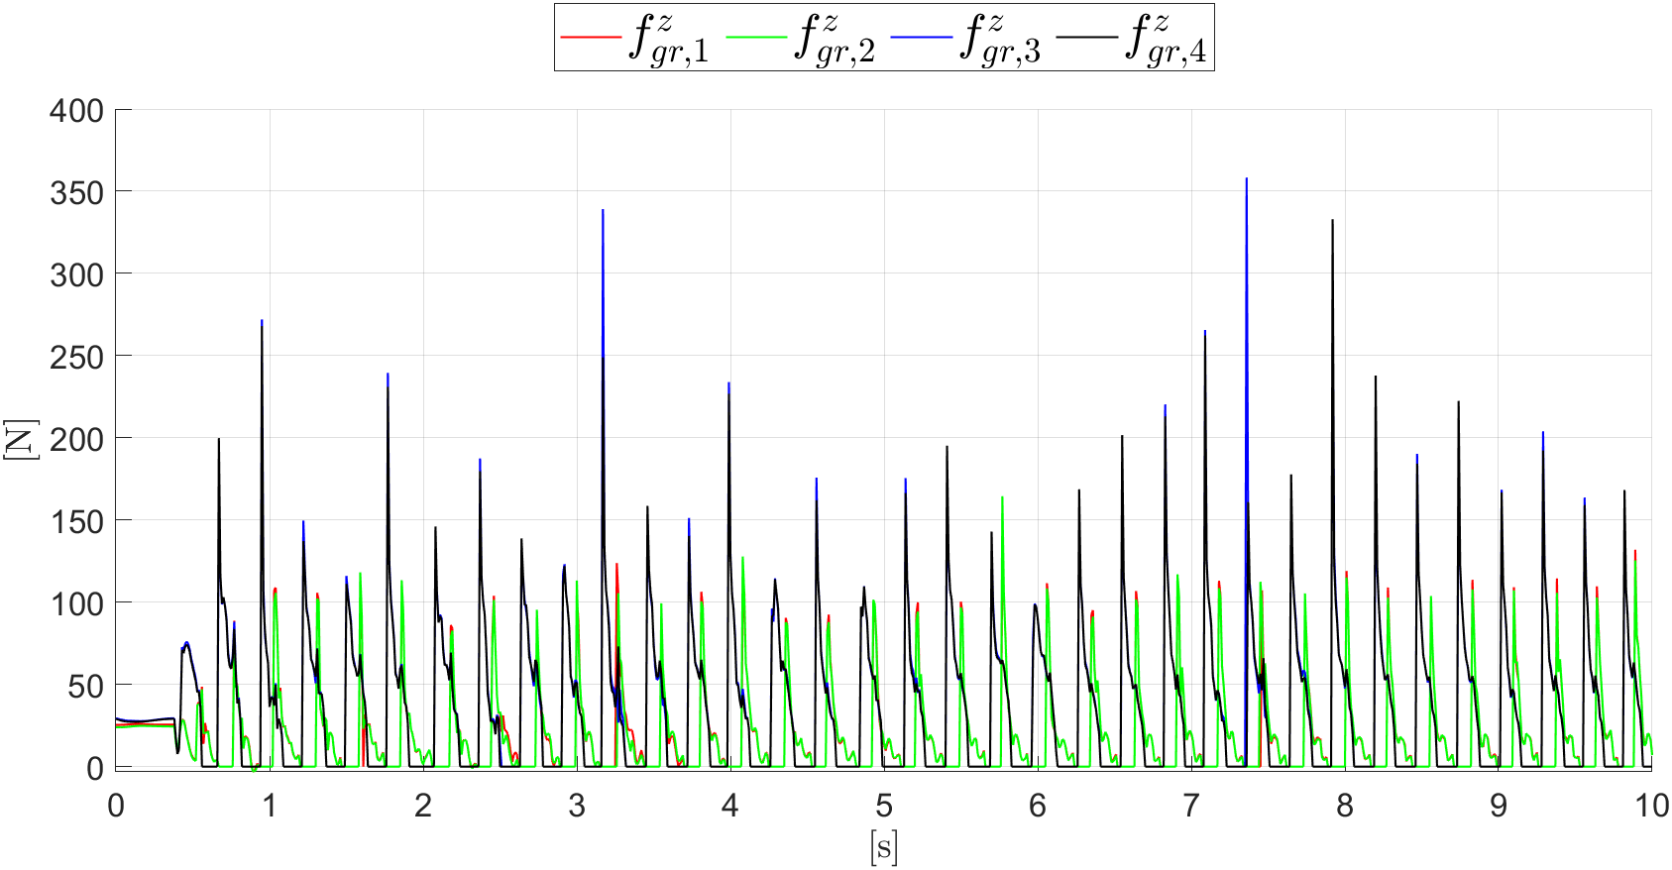

Linear Velocities
GAIT ANALYSIS – NEW BOUND
Angular Velocities
Ground Reaction Forces
$$v_{x,d}=0.3 \text{m}\text{/}\text{s}$$
MODEL-BASED AND DATA-DRIVEN CONTROL OF A QUADRUPED ROBOT 14 / 34

Slide 15
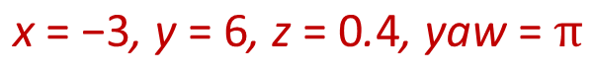
RRT PATH PLANNING
Robot moves in an environment full of obstacles
$$\text{x} \text{= −3}\text{, }\text{y} \text{= 6}\text{, }\text{z} \text{= 0}\text{.}\text{4}\text{, }\text{yaw} \text{=} π$$
MODEL-BASED AND DATA-DRIVEN CONTROL OF A QUADRUPED ROBOT 15 / 34

Slide 16
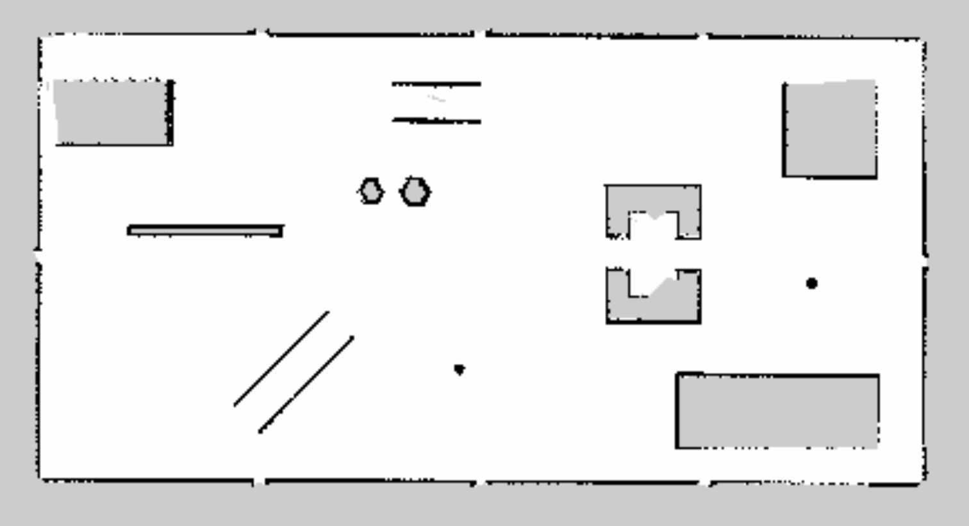
RRT PATH PLANNING
Set up:
Velodyne VLP-16 3D lidar sensor 2D Hokuyo Laser Scanner
Performance improvement: < real_time_update_rate > = 100 (rl_race_field.world)
Build the map using gmapping:
MODEL-BASED AND DATA-DRIVEN CONTROL OF A QUADRUPED ROBOT 16 / 34

Slide 17
RRT PATH PLANNING
Key steps:
Provide the map to move_base through the map_server node
Start the move_base node, specifying local (DWA) and global (RRT) planners
Start the Adaptive Monte Carlo Localization (AMCL) node to localize the robot
Launch RVIZ with a proper configuration to visualize the RRT planner
RRT implementation:
RRT_code.py planner algorithm
RRT_server.py planner available to the move_base node
treeviz.py tree graphical visualization
MODEL-BASED AND DATA-DRIVEN CONTROL OF A QUADRUPED ROBOT 17 / 34

Slide 18
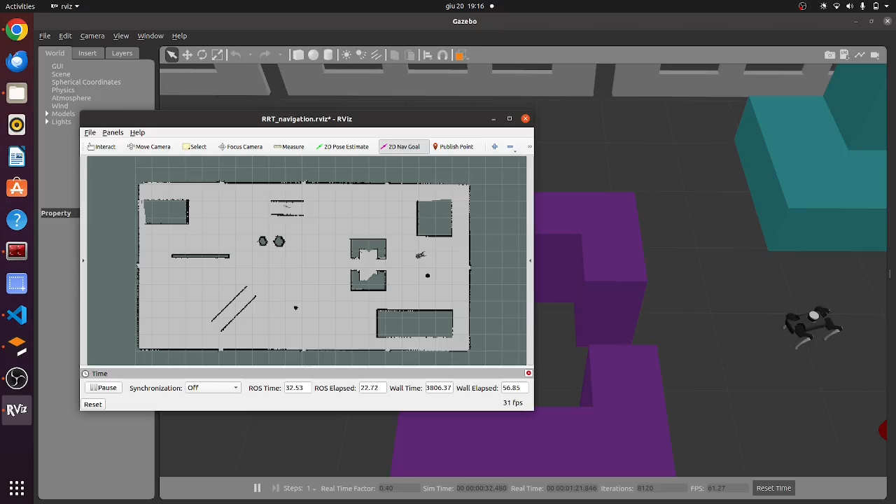
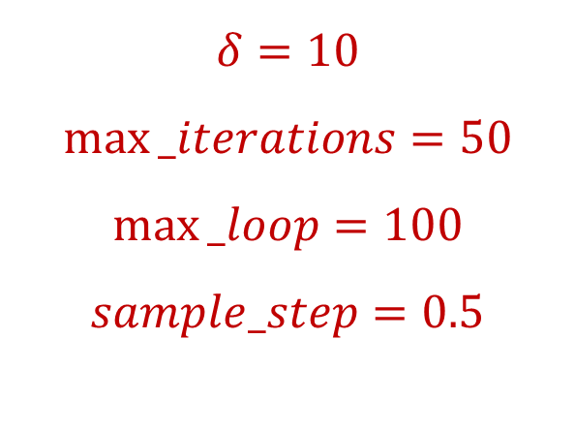
RRT PATH PLANNING
$$δ=10$$
$$max⁡_iterations=50$$
$$max⁡_loop=100$$
$$sample_step=0.5$$
MODEL-BASED AND DATA-DRIVEN CONTROL OF A QUADRUPED ROBOT 18 / 34

Slide 19
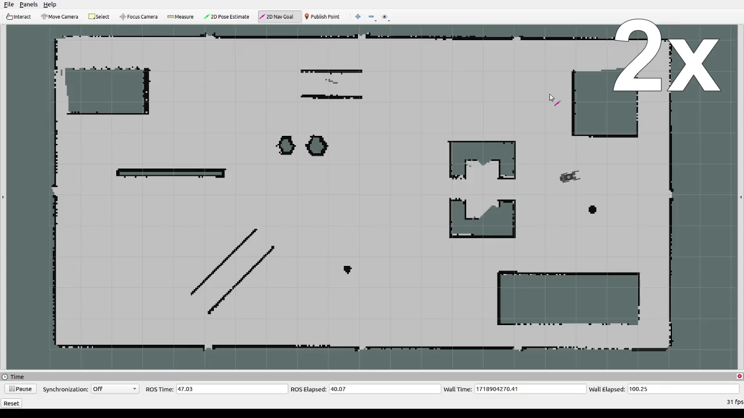
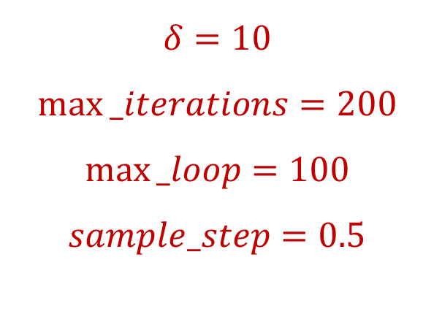
RRT PATH PLANNING
$$δ=10$$
$$max⁡_iterations=200$$
$$max⁡_loop=100$$
$$sample_step=0.5$$
MODEL-BASED AND DATA-DRIVEN CONTROL OF A QUADRUPED ROBOT 19 / 34

Slide 20
DATA-DRIVEN CONTROL
Deep Reinforcement Learning for controlling a quadruped robot
Unitree Aliengo Robot
RaiSim simulator
Reward Machines for learning specific gaits
Trot, Bound, Pace
MODEL-BASED AND DATA-DRIVEN CONTROL OF A QUADRUPED ROBOT 20 / 34

Slide 21
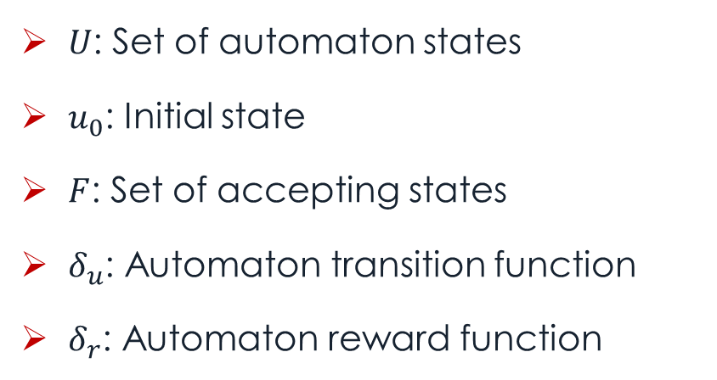

REWARD MACHINES
Used to specify sub-goals in larger task
Finite-state automaton
Extend the state with higher level variables
Still Markovian
Can avoid the use of curriculum learning
$$RM=(U,u_{0},F,δ_{u},δ_{r})$$
$U$: Set of automaton states
$u_{0}$: Initial state
$F$: Set of accepting states
$δ_{u}$: Automaton transition function
$δ_{r}$: Automaton reward function
MODEL-BASED AND DATA-DRIVEN CONTROL OF A QUADRUPED ROBOT 21 / 34

Slide 22
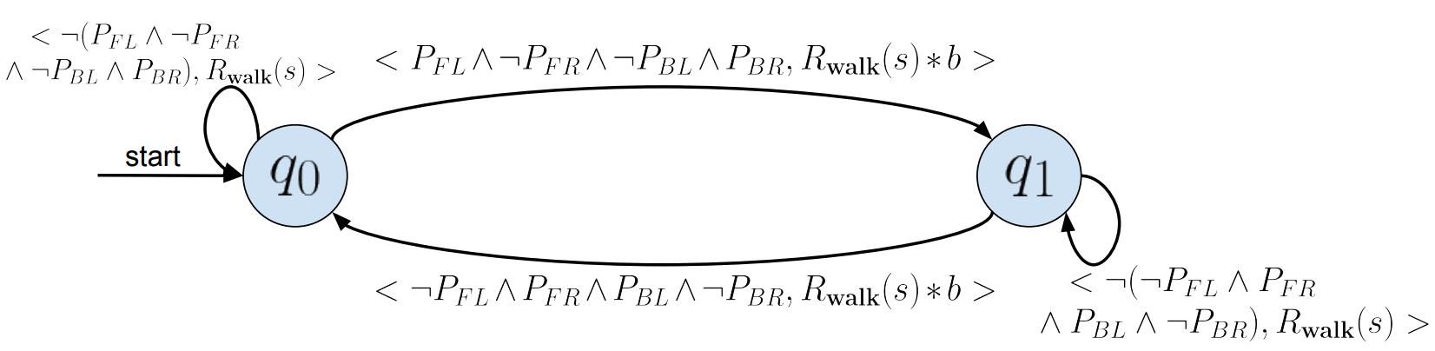
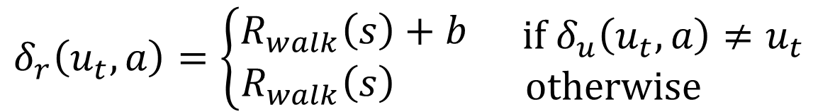
REWARD MACHINES
$$δ_{r}\left(u_{t},a\right)=\left\{\begin{aligned}R_{walk}\left(s\right)+b \\ R_{walk}\left(s\right) \end{aligned} \begin{matrix}\text{i}\text{f} δ_{u}\left(u_{t},a\right)≠u_{t} \\ \text{otherwise} \end{matrix}\right.$$
MODEL-BASED AND DATA-DRIVEN CONTROL OF A QUADRUPED ROBOT 22 / 34

Slide 23


STATE SPACE
$$S=\left(q,\dot{q},z,φ,v,ω,q_{t−1}^{target},q_{t−2}^{target},v_{d},u,δ,P\right)$$
$q$: 12 joint angles
$\dot{q}$: 12 joint velocities
$\dot{z}$: Body height
$φ$: Body orientation
$v$: Body linear velocities
$ω$: Body angular velocities
$q_{t−i}^{target}$: joints target at time $t−i$
$v_{d}$: Desired $x,y$ velocities
$u$: Current RM state
$δ$: Number of steps since previous RM state change
$P$: Vector of four boolean variables, that are 1 if the corresponding foot is tounching the groung
MODEL-BASED AND DATA-DRIVEN CONTROL OF A QUADRUPED ROBOT 23 / 34

Slide 24



ACTION SPACE
$$τ=K_{p}\left(q_{t}^{target}−q_{t}\right)−K_{d}{\dot{q}}_{t}$$
$$K_{p}=3, K_{d}=0.2$$
MODEL-BASED AND DATA-DRIVEN CONTROL OF A QUADRUPED ROBOT 24 / 34

Slide 25

REWARD FUNCTION
MODEL-BASED AND DATA-DRIVEN CONTROL OF A QUADRUPED ROBOT 25 / 34

Slide 26


Trot
Bound
Pace
REWARD EVOLUTION
Reward mean
Loss function
MODEL-BASED AND DATA-DRIVEN CONTROL OF A QUADRUPED ROBOT 26 / 34

Slide 27











MULTIPLE DESIRED VELOCITIES TRAINING
$$\begin{matrix}v_{d,x}=0 \\ v_{d,y}=0\end{matrix}$$
$$5 iterations$$
$$5 iterations$$
$$\begin{matrix}v_{d,x}=1 \\ v_{d,y}=1\end{matrix}$$
$$\begin{matrix}v_{d,x}=0.5 \\ v_{d,y}=0 \end{matrix}$$
$$5 iterations$$
$$5 iterations$$
$$\begin{matrix}v_{d,x}=0.5 \\ v_{d,y}=0.5\end{matrix}$$
$$\begin{matrix}v_{d,x}=1 \\ v_{d,y}=0\end{matrix}$$
$$5 iterations$$
$$5 iterations$$
$$\begin{matrix}v_{d,x}=0 \\ v_{d,y}=1\end{matrix}$$
$$\begin{matrix}v_{d,x}=0 \\ v_{d,y}=0.5\end{matrix}$$
$$5 iterations$$
MODEL-BASED AND DATA-DRIVEN CONTROL OF A QUADRUPED ROBOT 27 / 34

Slide 28

PROXIMAL POLICY OPTIMIZATION (PPO)
Actor-critic DRL algorithm
Multi-layer perceptron 256-128-32 neurons with Leaky ReLU
100 steps for each episode
Each episode last 4 s
30 simulation in parallel
Training of 1200 iteration for all three gaits
Sampling time: 0.0025, 0.01
MODEL-BASED AND DATA-DRIVEN CONTROL OF A QUADRUPED ROBOT 28 / 34

Slide 29





Linear Velocities
GAIT ANALYSIS – TROT
Angular Velocities
Position
$$v_{x,d}=1 \text{m}\text{/}\text{s}$$
MODEL-BASED AND DATA-DRIVEN CONTROL OF A QUADRUPED ROBOT 29 / 34

Slide 30




Linear Velocities
GAIT ANALYSIS – BOUND
Angular Velocities
Position
$$v_{x,d}=1 \text{m}\text{/}\text{s}$$
MODEL-BASED AND DATA-DRIVEN CONTROL OF A QUADRUPED ROBOT 30 / 34

Slide 31




Linear Velocities
GAIT ANALYSIS – PACE
Angular Velocities
Position
$$v_{x,d}=1 \text{m}\text{/}\text{s}$$
MODEL-BASED AND DATA-DRIVEN CONTROL OF A QUADRUPED ROBOT 31 / 34

Slide 32

EXPLOIT ALL GAITS FOR A TASK
MODEL-BASED AND DATA-DRIVEN CONTROL OF A QUADRUPED ROBOT 32 / 34

Slide 33
CONCLUSIONS
Model-based Control:
Effective with well-known system models, and clear what the control is doing
Deterministic, easy to validate for critic applications
Computationally demanding, and not optimal in highly dynamic and complex environments
Data-driven Control:
Unnecessary modeling of complex systems
Continuous improvement with large amounts of data
Lots of training time and attempts, and very stochastic
MODEL-BASED AND DATA-DRIVEN CONTROL OF A QUADRUPED ROBOT 33 / 34

Slide 34

THANKS FOR YOUR ATTENTION!!
MODEL-BASED AND DATA-DRIVEN CONTROL OF A QUADRUPED ROBOT 34 / 34

